Slide 1
Kofax Transformation Community of Practice
5 July 2022. Advanced Classification
David Wright
Partner Enablement Manager

Slide 2


Notes:
Great KT solutions build wonderful collaboration between humans and robots. Robots always support humans, never replace them. This picture describes in great detail what we are doing with Kofax Transformation – always putting the human in the center and in control, with human hands on the keyboard. The human never gives control to the robot and the human remains always responsible. We do not let AI make decisions about human lives – only humans can do that.

Slide 3

Kofax Transformation Community of Practice
Each month
Topics that are relevant to you as Kofax Transformation users
Send me any topics you would like to see covered at david.wright@kofax.com
https://github.com/KofaxTransformation for all links and content.
June 2022 – Threshold Optimizer
July 2022 – Advanced Classification
August 2022 – No sessions due to Northern Summer

Slide 4

Classification
What is classification
Custom Classification
Classification Tips

Slide 5
Classification Methods
Layout
Text (Content/Adaptive Feature Classifier)
Instructional (I will completely skip this! Please do not use!)
Script classification

Slide 6
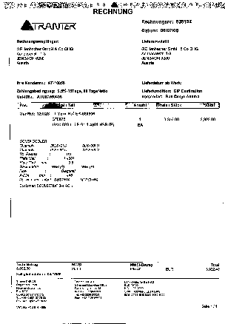
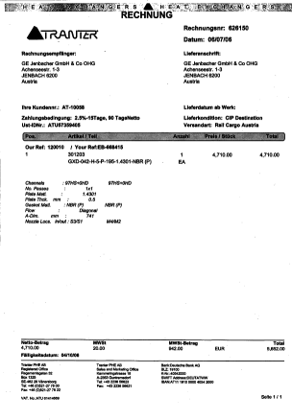
Layout Classification – VERY fast (~100 pages/second) no OCR

Slide 7
Text Classification – letter N-grams into Bag-of-Words very fast (after OCR)
Wir sandten Ihnen auf Ihre Rechnung und Gefahr
3-grams: wir irs san and ndt dte ten eni nih …
4-grams: wirs irsa rsan sand andt dten teni enih nihn ihne hnen
5-grams: wirsa irsan rsand sandt andte ndten dteni tenih enihn nihne ihnen
25-grams wirsandtenihnenaufihrerec irsandtenihnenaufihrerech …

Slide 8
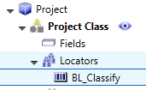
Custom Classification. (Barcode Classification)
Add a Barcode Locator to Project Level Add this project level script
Private Sub Document_AfterClassifyXDoc(ByVal pXDoc As CASCADELib.CscXDocument)
Dim Alternative As CscXDocFieldAlternative, C As Long, Match As Boolean
With pXDoc.Locators.ItemByName("BL").Alternatives
If .Count=0 Then Exit Sub ' No barcode was found, so no custom classification
Set Alternative=.ItemByIndex(0)
End With
'Check that the Barcode contains a valid class name
For C=0 To Project.ClassCount-1
If Project.ClassByIndex(C).Name=Alternative.Text Then
Match=True
Exit For
End If
Next
If Not Match Then Exit Sub ' The barcode does not contain a valid class name
' reclassify the document according to the barcode
pXDoc.Reclassify(Alternative.Text, Alternative.Confidence)
End Sub

Slide 9
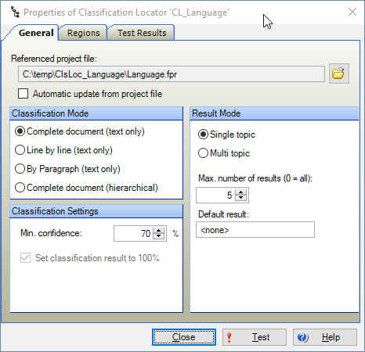
Classification Locator
Use another project to classify documents.
Compatible with all versions of KT
Total Agility
RPA
KTM
KTT
Mobile Capture

Slide 10
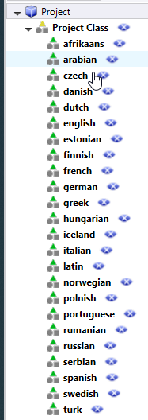
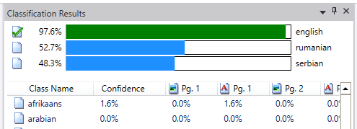
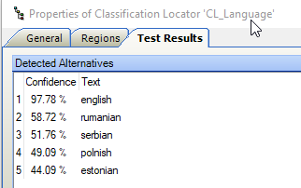
Language Detection
A document is classified as “english” in the classification project
In the classification locator each language is an alternative.
A powerful technique to divide and conquer
and simplify

Slide 11

Language Detection
This project is delivered with KT
It is not fantastic.
This RPA robot, https://github.com/KofaxTransformation/KTScripts/tree/master/LanguageClassification, downloads 1000 random articles from Wikipedia per language for training, and 100 random articles for testing.
It provides EXTRAORDINARY ACCURACY in language detection.

Slide 12
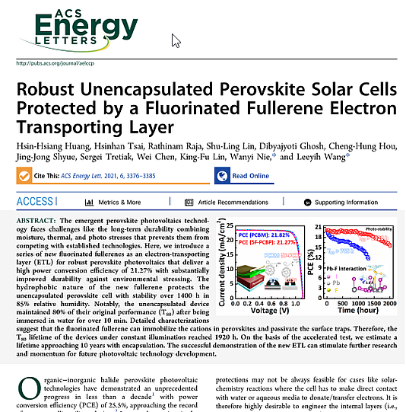
Paragraph Classification
Scientific Paper Processing.
Title
Authors
Abstract

Slide 13
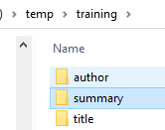
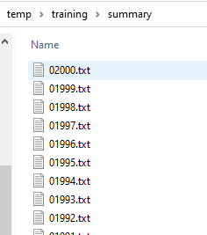

Train a Scientific Paper Classification Model
Download 2000 titles, authors and abstracts from arxiv.org

Slide 14
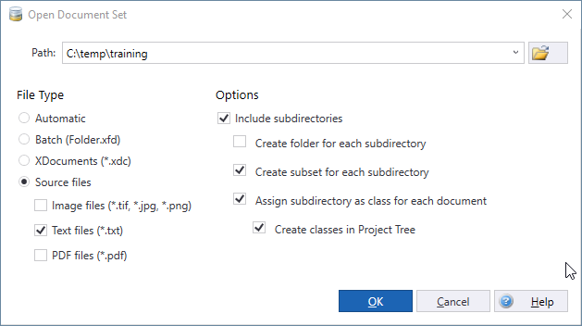
Import into Kofax Transformation
Create a new KT project
Import all 8000 text files into a new Document Set
This creates all classes and subsets.

Slide 15
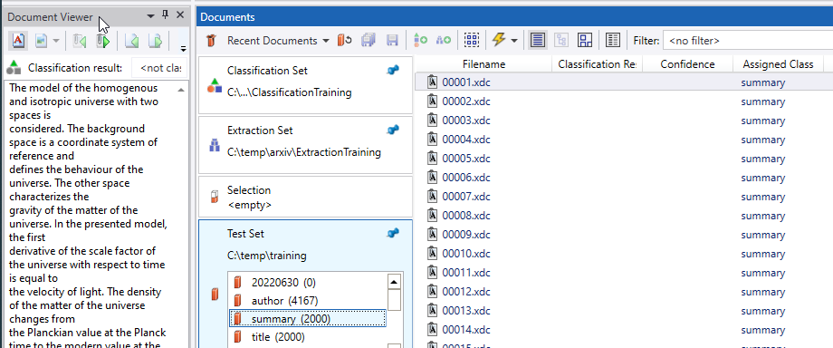
Testset subsets are atuomation
Each document is added to its subset and the assigned class is set/

Slide 16
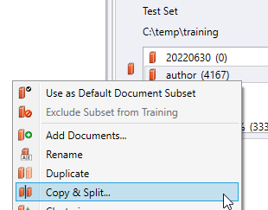
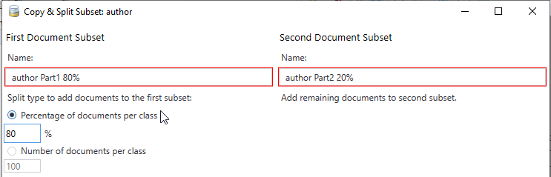
Split each subset into training and testing subsets
Copy & Split at 80%.
This randomly splits the files into 80% training and 20% testing.
This is STANDARD PRACTICE in AI and machine learning.
A further step is to split-train-benchmark and then repeat 5 times – the final benchmark scores are then the average of 5 or more runs…

Slide 17
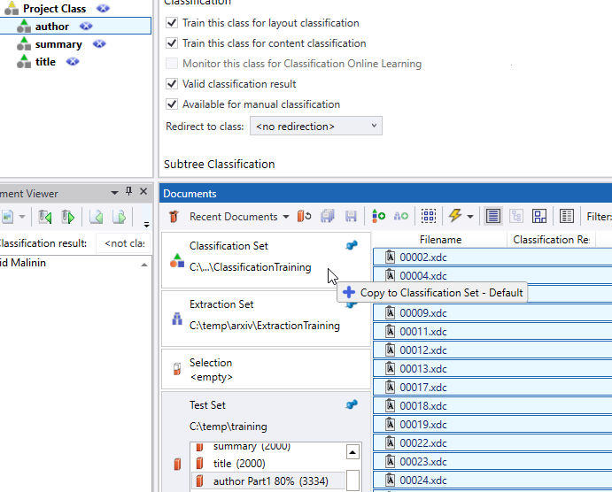
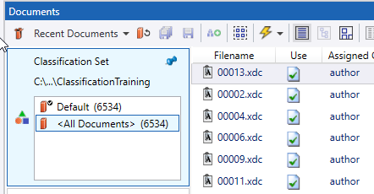

Add all training samples to their classes as training samples

Slide 18
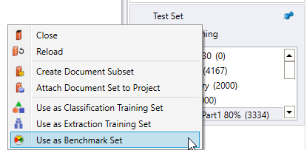
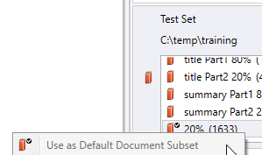
Convert to a Benchmark set
Drag all the 20% samples into a new subset and set as the Default Document Subset.

Slide 19
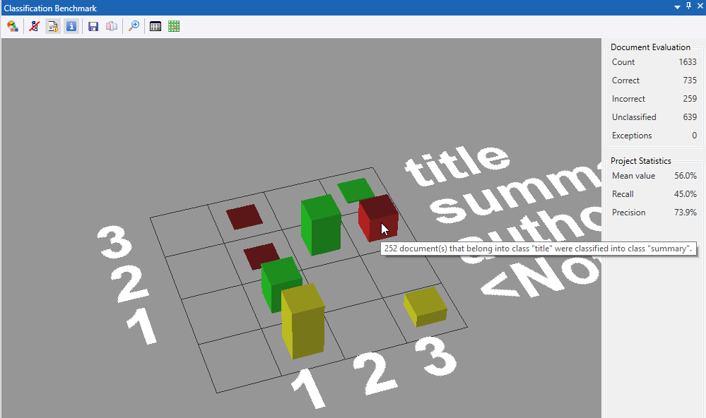
Run the Classification Benchmark

Slide 20





What to do next?
Lots of great ideas die at the benchmark. This may not be a great idea.
Here we should train negative examples – a 4th category.
Find other ideas.
Combine ideas together to enhance their strengths.
Don’t forget your humans are there! – Use them

Slide 21
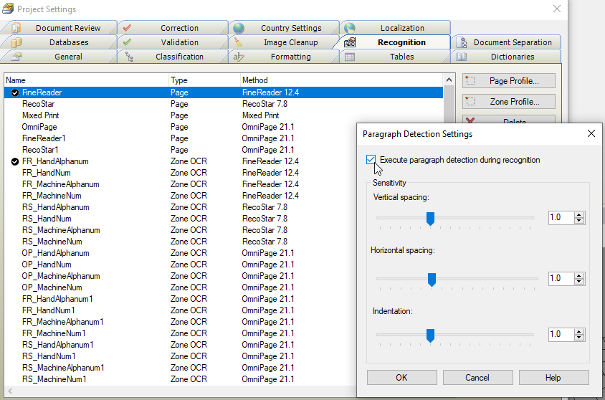
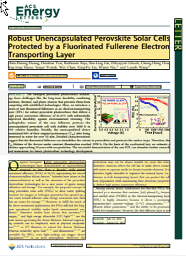
Paragraph Detection is new in Kofax Transformation

Slide 22
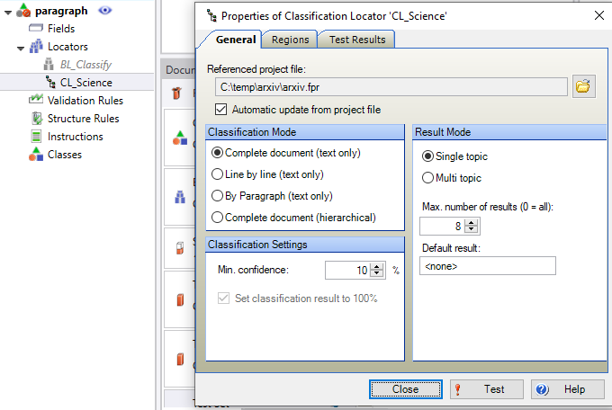
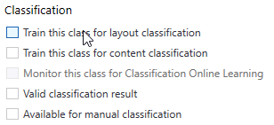
Paragraph Classification
Add a paragraph class with the Classification Locator
Deselect all classification settings for this class

Slide 23
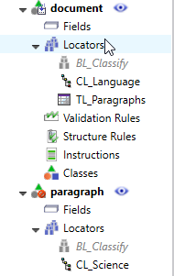
Main Class
The main class has a Classification Locator and a Table Locator
Script is at https://github.com/KofaxTransformation/KTScripts/blob/master/Paragraph%20Classification.md

Slide 24
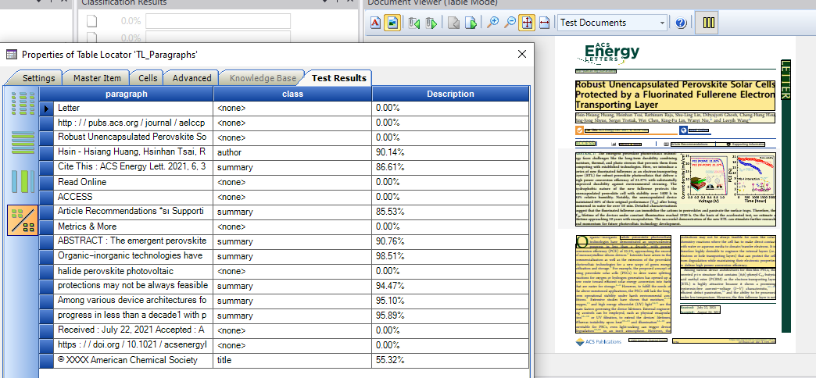
Paragraphs are now classified

Slide 25
Q&A

Slide 26

Thankyou!
Check cvent for upcoming webinars, Communities of Practice, video playback, and downloads.
https://cvent.me/Y7gqWA

